Slide 1

Final Project Data Analyst
Hanif Dwi Satria DS32A+

Slide 2

About Me
Experience
July - August 2024
Internship Trainee
Badan Pusat Statistik
Education
February 2025
- Now
Data Science Bootcamp
Dibimbing
Hanif Dwi Satria
Linkedin
November - December 2024
Data Analyst Bootcamp
MySkill
August 2024- July 2020
Bachelor of Science of Mathematics
Institut Teknologi Sepuluh Nopember

Slide 3
Recent Project
Exploratory Data Analysis with Ecommerce
Link
Analyzing some of handling data that error and also solving some of business problem about sales and quantity in each segment.
Tools : Python
Query SQL With Retail in Tokopedia (not real)
Link
Analyzing the total transaction for some segment like category, month, and sku_detail to see each performance by year.
Tools : SQL

Slide 4

Table of contents
04
01
05
02
06
03
Preprocessing Data
Background Project
Objective & Business Problem
Find and Insight
Recommendation
Understanding Data

Slide 5
01
Background Project

Slide 6
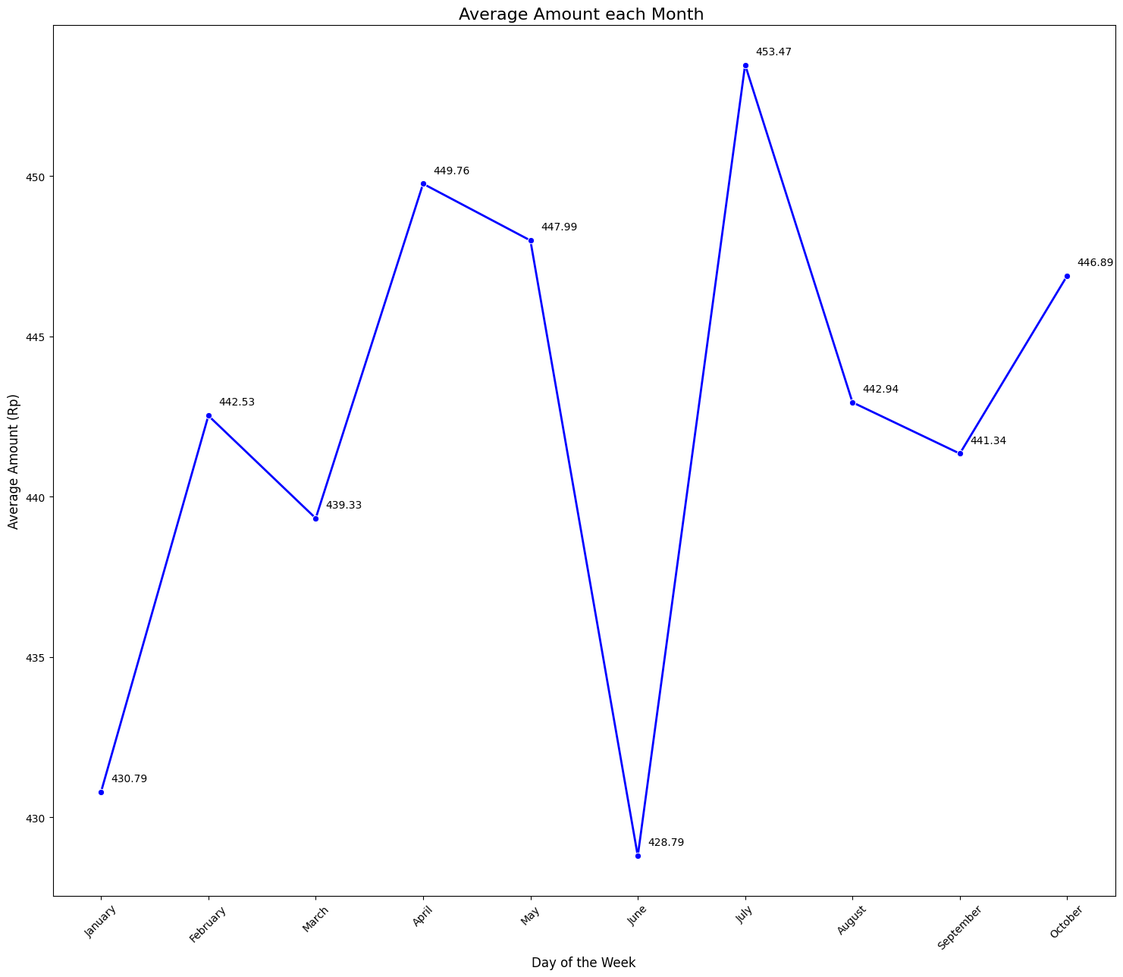
Background Project
In every transaction amount, always getting better even though always getting up & down every month. But in the sum of customer of transaction, the result is same getting up & down, and surprisingly in october is the lowest point on it.

Slide 7
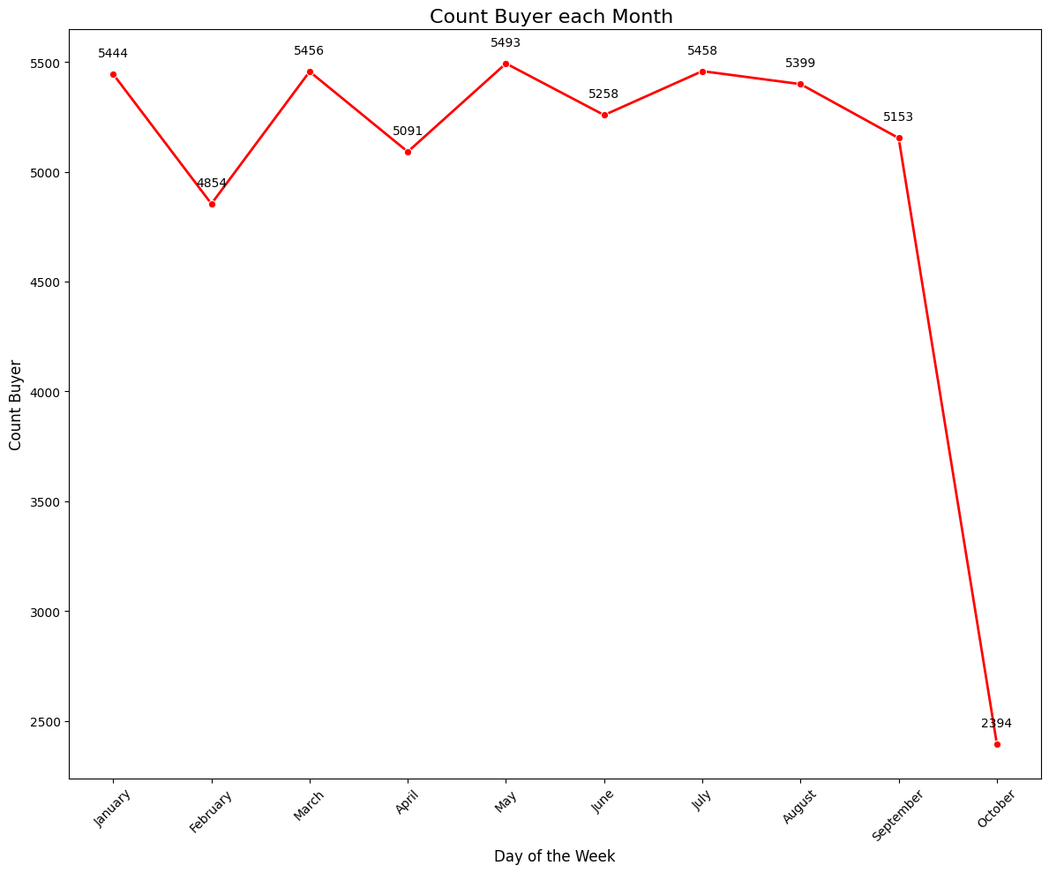

Slide 8
02
Objective & Business Problem

Slide 9
Objective & Business Problem
Objective : To get know customer transaction personality from every segment on it. The technique for this problem is RFM analysis. This method will be hope getting a new insight and recommendation to get better of this company.
Business Problem :
In which group age that have the highest total transaction based on gender ?
Which one of customer segment that have the highest count of customer ?
From 2023, which date that have the highest count of customer ?
In which category that have the highest transaction amount. How many customer in there based on gender ?
Who is the customer to get the highest total of monetary ?

Slide 10
03
Understanding Data

Slide 11

Understanding Data
Dataset from kaggle, with the content of customer transaction
Information data like Customer ID, Name, Surname, Gender,BirthDate, Transaction Amount, Date with the year of 2023, Merchant Name, and Category
Contain 51.000 data with 9 columns

Slide 12
04
Preprocessing Data

Slide 13
Preprocessing Data
Step 1
Handling
Duplicate
Step 2
Handling
Missing Value
Step 3
Change Data Type
Step 4
Handling Outlier
No any Duplicate of Data
Change the NULL in Gender into ‘F’
Date (Object) -> Date
BirthDate(Object) -> Date
One outlier, but the boxplot its still clear
Colab : Link

Slide 14
Customer Segment Score
5
4
3
2
1
Recency Score
700 Days
750 Days
800 Days
850 Days
1
2
3
4
5
Monetary Score
75 $
150 $
300 $
600 $
1
2
3
4
5
Frequency Score
2 Transactions
4 Transactions
6 Transactions
8 Transactions

Slide 15
05
Find And Insight

Slide 16
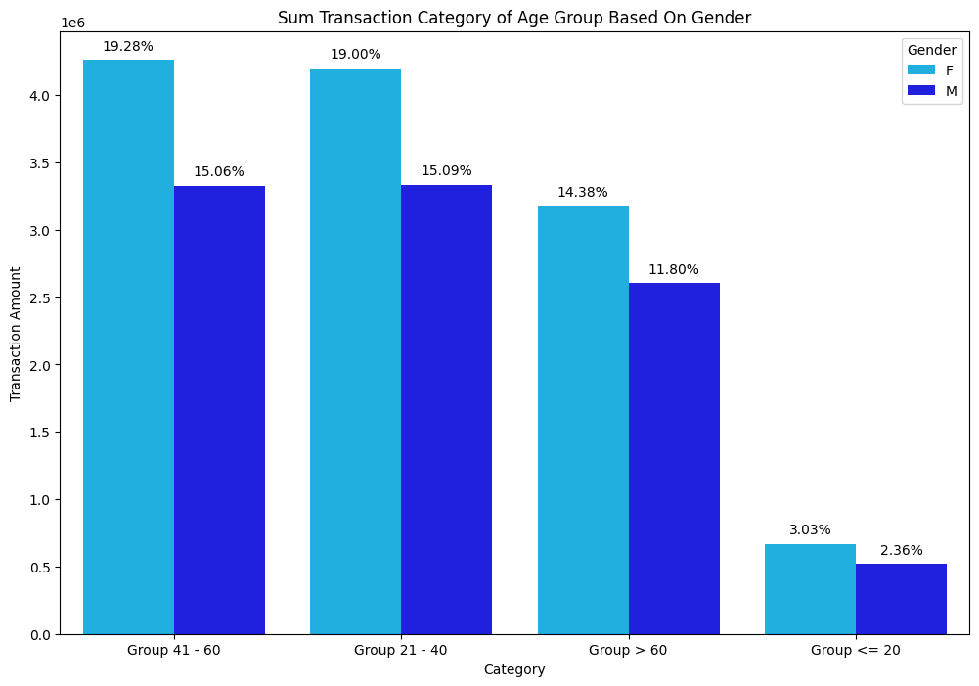
Find And Insight
In which group age that have the highest total transaction based on gender ?
Insight :
Age 41-60 is the highest transaction with 19.28% for female and 15.06% for Male(Green)
Age <= 20 is the lowest transaction with 3.03% for female and 2.36% for male (red)

Slide 17
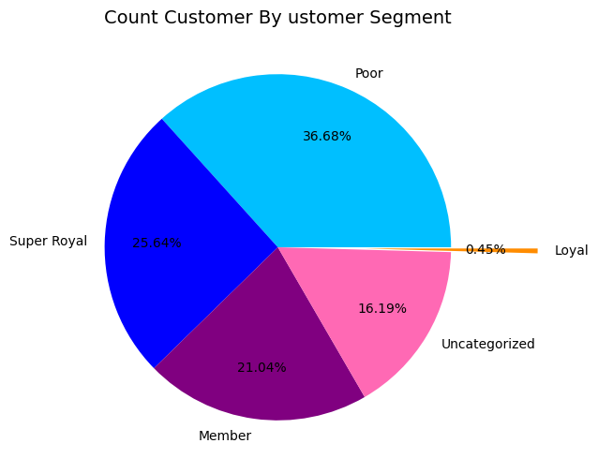
Find And Insight
2. Which one of customer segment that have the highest count of customer ?
Insight :
Poor segment is the highest amount customer for doing transaction with 36.68 % (Green)
Loyal is the least amount customer for doing transaction with 0.45 %
(Red)

Slide 18
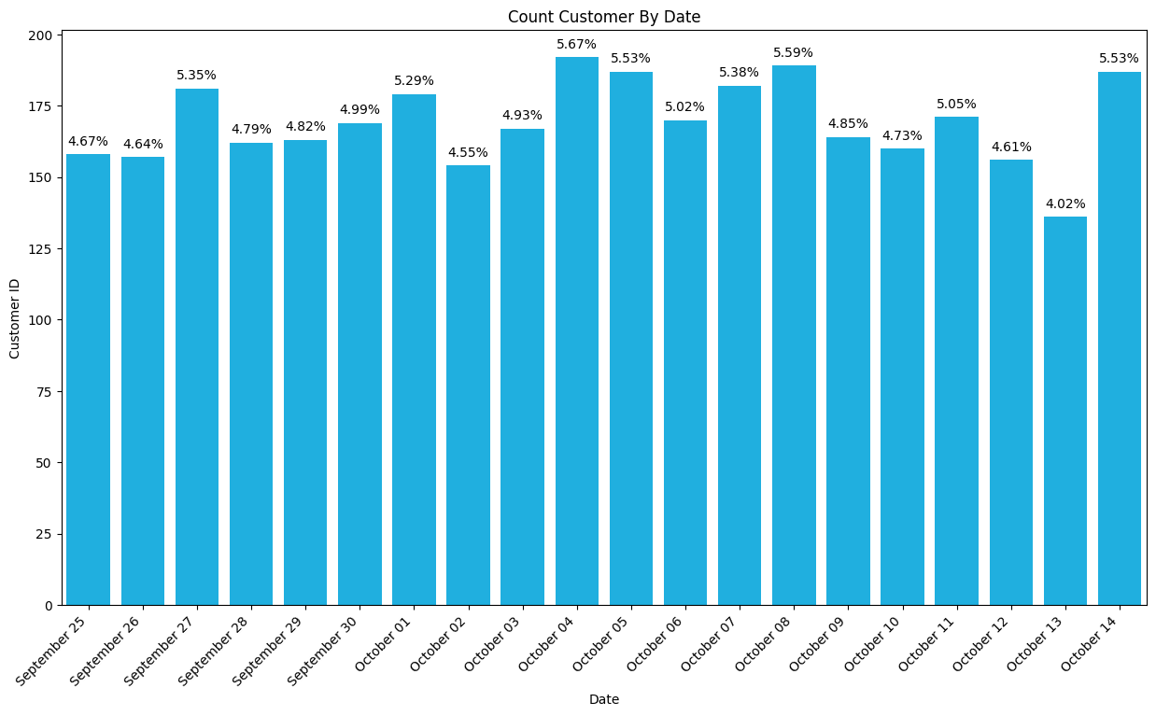
Find And Insight
3. From 2023, which date that have the highest count of customer ?
Insight :
On the 4 October 2023, the amount customer is the highest one with 5.67 % (Green)
On the 13 October 2023, the amount customer is the lowest one with 4.09 %
(Red)

Slide 19
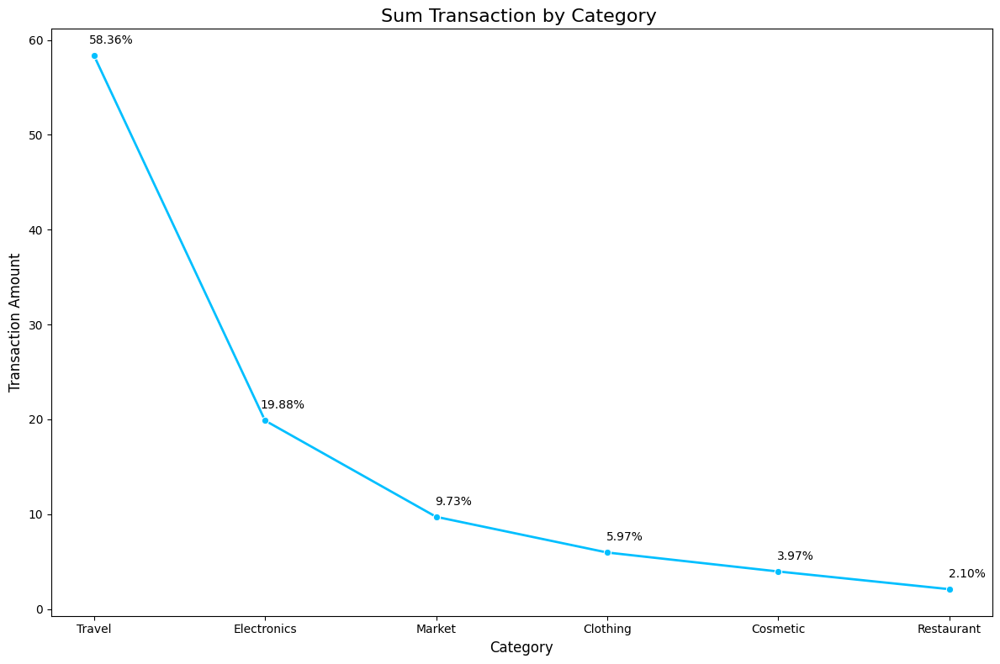
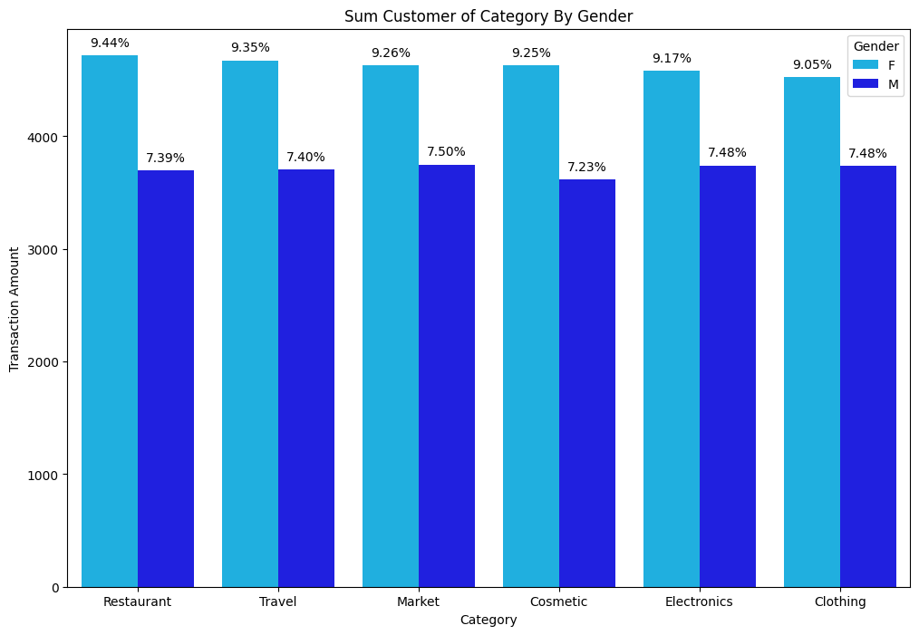
4. In which category that have the highest transaction amount. How many customer in there based on gender ?
Insight :
The travel is the highest transaction with 5.86% and the total customer 9.35% for female and 3.47% for male(Green)
The restaurant is the lowest transaction with 2.1% and the total customer 9.44% for female and 7.39% for male(red)

Slide 20
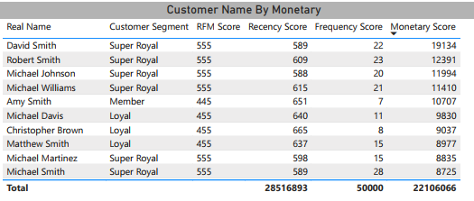
Find And Insight
5. Whos is for the customer to get the highest total of monetary ?
Insight :
Based on top 10 / 11 customer, the highest monetary is on the customer of David Smith with super royal segment. (Green)
Based on top 10 / 11 customer, the lowest monetary is on the customer of Michael Smith with super royal segment. (red)

Slide 21
06
Recommendation

Slide 22
Recommendation
Based on business problem that already solve it, Here’s some of recommendation for increasing of transaction or customer to get back on company :
Prioritized on the age of 41-60 of transaction and some of customer in monetary
Promoting our product in social media especially Facebook, Collaborating with the banks for the credit / debit card payment, and giving coupon like discount or buy 1 get 1 for the product.
Try to persuade for the customer segment of poor
Playing games with poor people to get discount of product, Giving a promo for the people who come at first this etalase, and Inviting the poor people to be our member.
Boosting up customer in the end of the year (october)
Promotion in bazzar to get know in global, giving sample of product in free especially 13 october, making a unique content like self endorsement.
Focusing on Restaurant category of transaction
Collab with some customer to ask some positive review in social media, giving some of demonstration product by employee to get the trust of customer.

Slide 23
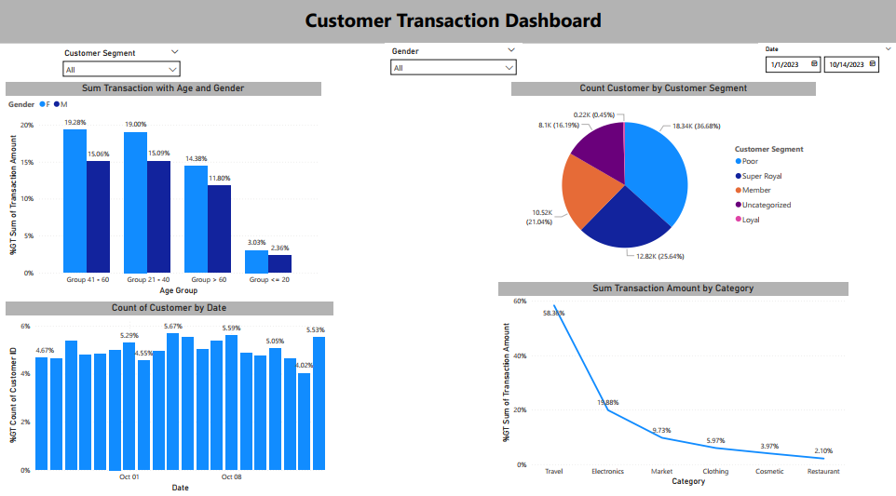
Analysis Dashboard
To Support each continent of business problem. Here’s the dashboard that related to our stakeholders.

Slide 24
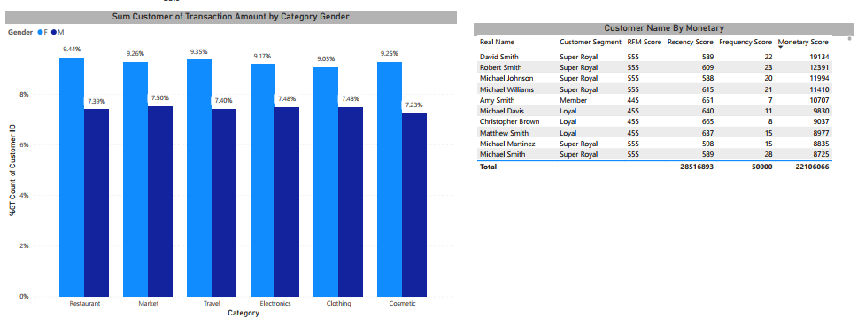
Analysis Dashboard
Power BI : Link

Slide 25
Thanks!
Do you have any questions?
hanifdwisatria6@gmail.com
+62 812 8402 8370
Please keep this slide for attribution

